Slide 1

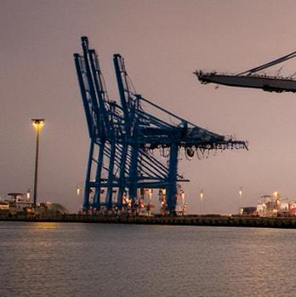

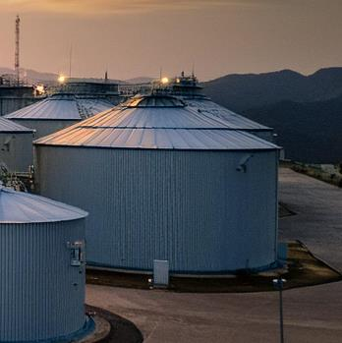
Improving national accounts and GDP
The results of South Africa’s rebasing
and benchmarking exercise, 2026
Reference year: 2022
Risenga Maluleke
Statistician-General
Embargo: 29 October 2026
11h00

Slide 2


Overhauling national accounts and GDP
Photo: Johannes Plenio, unsplash.com
2

Slide 3
Rebasing and benchmarking is done to ensure better estimates of GDP
Adopting new methodologies and classifications
Statistical offices should periodically review the way in which they measure the economy (e.g. the non-observed economy)
Remaining relevant
Economies are dynamic. The process of rebasing and benchmarking is essential to identify structural shifts in the economy
Informing other indicators
GDP data feed into other national indicators that are used to inform policy decisions
3

Slide 4
A history of rebasing and benchmarking exercises in South Africa, by base year
1995
2000
2005
2010
2015
+13,5%
+3,8%
+1,8%
+2,8%
+9,2%
Published in 1999
Implementation of 1993 SNA
Inclusion of new sectors (informal sector and telecommunications)
Published in 2004
New taxation-based business register
Introduced SUTs to calculate annual estimates (95 industries, 28 products)
Published in 2009
Introduced the non-observed economy
Expansion of the SUT to 292 industries, 105 products
Published in 2014
Implemented SNA 2008
Capitalisation of R&D and expenditure on weapons systems; employee stock options as COE; refined method to calculate FISIM
New datasets included:
IES 2010/11; industry large-sample surveys; Census 2011; detailed price data
Published in 2021
New methods
Refined industry and product classifications; new SUT framework; calendarization; taxes on products & production; trade & transport margins; trade services
A range of new internal and external data sources
4

Slide 5
Rebasing and benchmarking defined
Feature
Rebasing
  1. Rebasing
  2. Benchmarking
Core purpose | Updates the base year (e.g. changing the base from 2015 to 2022) to reflect modern economic structures and relative prices.
What it changes | Changes the reference point and weights.
Frequency | Conducted periodically, typically every 5 years.
Core purpose | Harmonises discrepancies between high frequency and periodic data sets. Improvements in methodology.
What it changes | Changes the values and growth rates of the historical data to ensure consistency.
Frequency | Conducted periodically, typically every 5 years.
5
Notes:
Remove Covid-19 sentence.

Slide 6

Improvements made
Photo: Pema Gyamtsho, unsplash.com
6

Slide 7
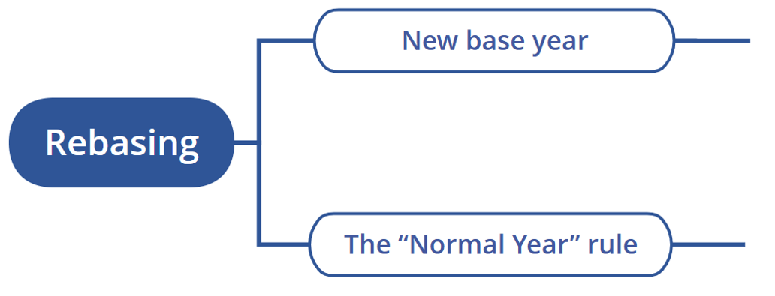
Rebasing
The base (reference) year has been changed from 2015 to 2022
The SNA states that a benchmark year must be an economically “normal” year. Because the COVID-19 pandemic severely distorted economic data in 2020 and 2021, Stats SA pushed the traditional timeline out and selected 2022 as the new, stable base year
7

Slide 8
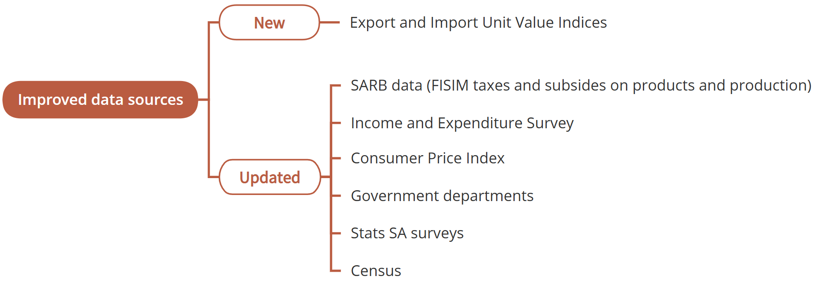
Benchmarking: New and improved data sources
8

Slide 9
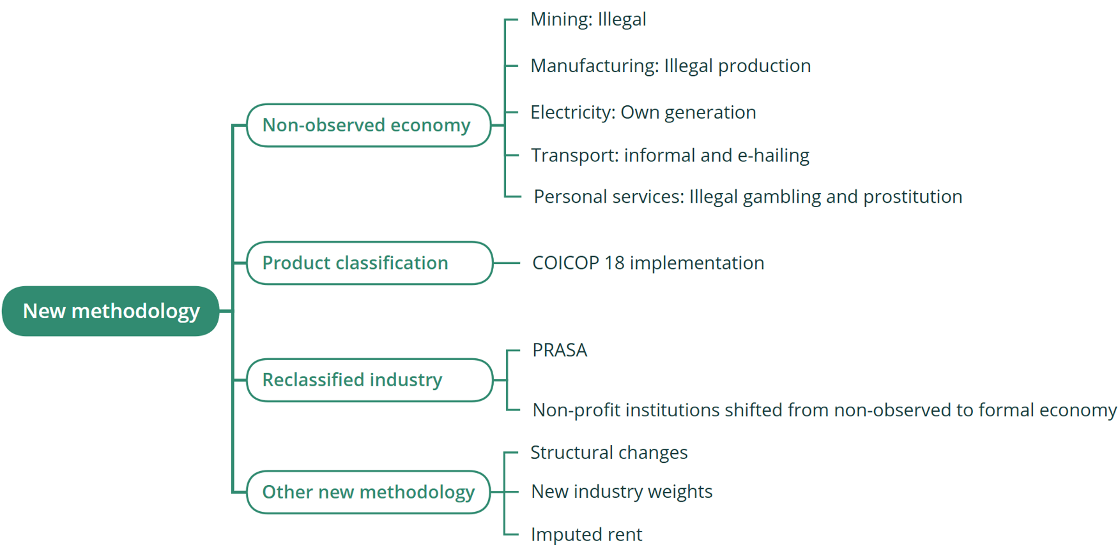
Benchmarking: New methodology
9

Slide 10
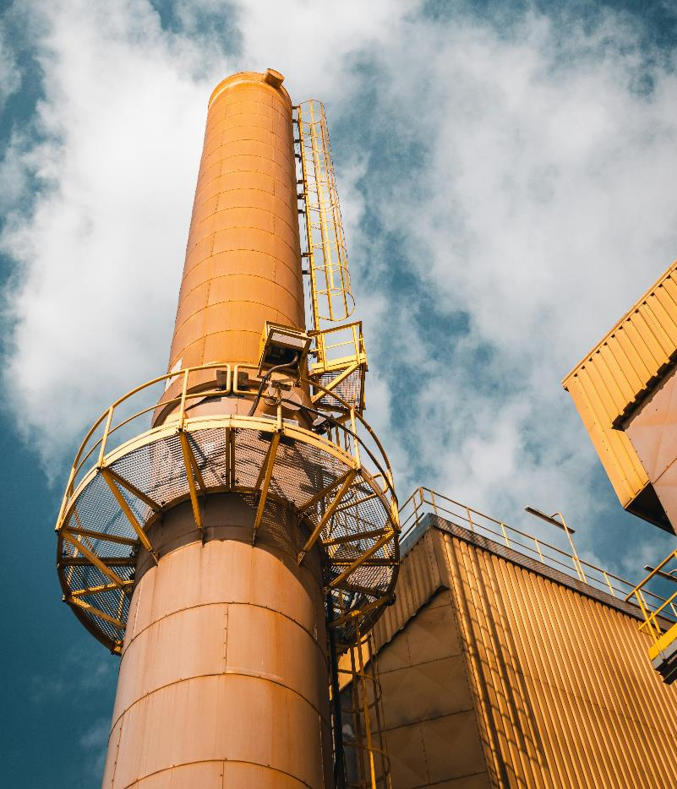
Results of 2022 benchmarking
Photo: Jakub Pabis, unsplash.com
10

Slide 11
GDP production: Levels in current prices
The economy is 4,9% larger in the base year of 2022
+5,3%
R8 044 billion
+4,8%
+4,6%
R7 642 billion
+4,9%
R6 990 billion
+4,3%
R6 667 billion
+3,9%
+4,3%
+3,5%
+3,7%
+3,7%
+3,5%
Backcasted
Benchmarked
Revised
11

Slide 12
GDP production: Real GDP growth rates
The revised growth rate in 2022 is 2,2%. This is higher than the previous rate of 2,1%
Backcasted
Benchmarked
Revised
Based on GDP measured by production
12

Slide 13

The revised estimate of the economy’s size was mainly driven by data improvements and better coverage
89%
Improved data
The economy is 4,9% larger in the base year of 2022
Led to an upward shift in the size of the economy
11%
Methodological changes
13

Slide 14
GDP production: Estimates of industry levels of value added in the 2022 base year
Change between previous and revised estimates. Finance recorded the largest upward revision
In current prices
14

Slide 15

GDP production: Reasons for upward revision of finance
+R118bn
Real estate services
Owner-occupied housing
Methodology improvement
+R127bn
Upward revision
+R20bn
Financial intermediation, insurance & business
Methodology improvement (70%)
Better coverage (30%)
+R5bn
Non-observed economy
Methodology improvement
-R16bn
Other business services
Better coverage
Figures have been rounded and may not sum to total
15

Slide 16

GDP production: Reasons for upward revision of trade
+R27bn
Wholesale, retail & accommodation
Better coverage
+R61bn
Upward revision
+R34bn
Non-observed economy
Methodology improvement
Figures have been rounded and may not sum to total
16

Slide 17
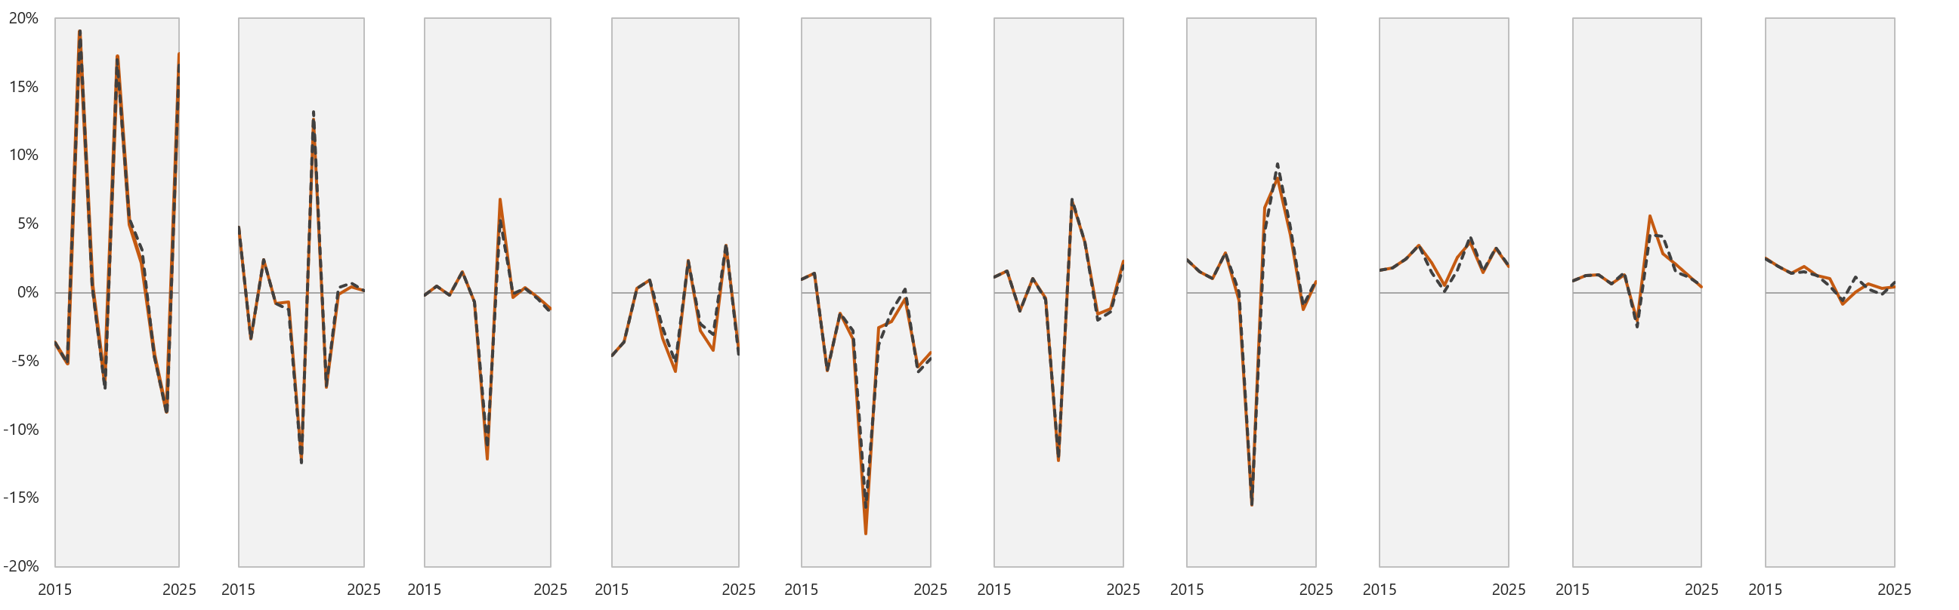
GDP production: Real industry growth rates, 2015–2025
▬ Previous (based on 2015 prices) ⋯ Revised (based on 2022 prices)
Agriculture
Mining
Manufacturing
Electricity
Construction
Trade
Transport
Finance
Personal services
Government
17

Slide 18
Expenditure on GDP: Previous and revised estimates of component levels in the 2022 base year
Change between previous and revised estimates. Household final consumption expenditure registered the largest upward revision
In current prices
18

Slide 19

Expenditure on GDP: Reasons for upward revision in household final consumption expenditure
+R125bn
Income and Expenditure Survey
Updated data
+R89bn
Non-observed economy
New methodology
+R315bn
Upward revision
+R101bn
Owner occupied
Methodology change
19

Slide 20
Expenditure on GDP: Household consumption expenditure in the 2022 base year
Change between previous and revised estimates for household consumption expenditure components
In current prices
20

Slide 21
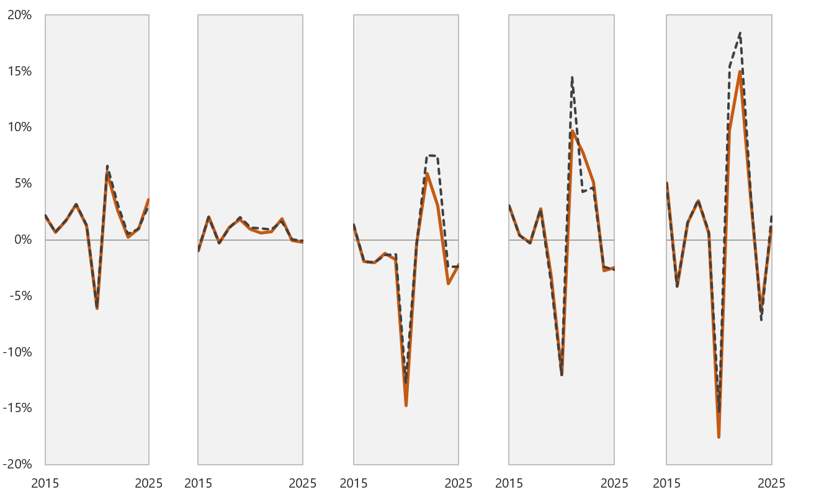
GDP by expenditure: Component growth rates, 2015–2025
▬ Previous (based on 2015 prices) ⋯ Revised (based on 2022 prices)
Household consumption
Government consumption
Capital formation
Exports
Imports
21

Slide 22
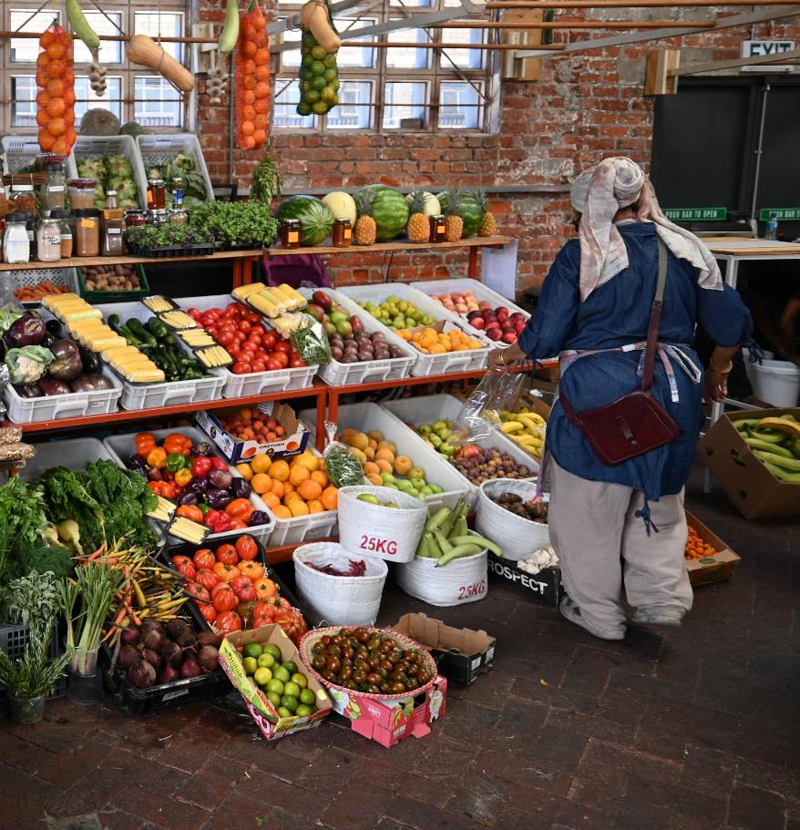
The non-observed economy
Photo: Tanya Paquet, unsplash.com
22

Slide 23
The non-observed economy
The core definition did not change between SNA 1993 and SNA 2008
The definition
All productive activities not included in basic data collection that is still within the production boundary
The goal
Complete coverage of the production boundary
23

Slide 24
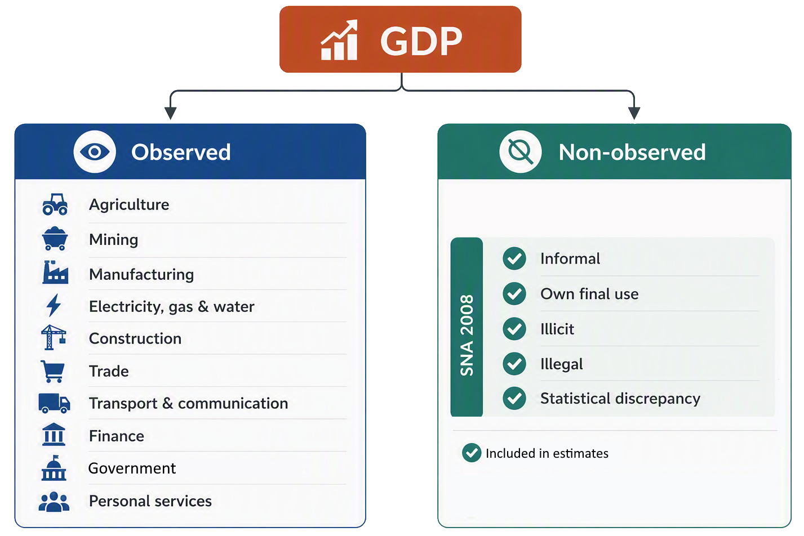
The components of the non-observed economy
24

Slide 25
Evolution of non-observed measurement in South Africa
1995
Spaza shops; informal taxi transportation; subsistence agriculture
2005
Unregistered construction workers; street hawkers and open markets; small-scale informal; manufacturing; backyard mechanics; informal catering, cooked food stalls; shebeens; illegal transport
2015
Digital/gig related household services; informal water fetching; informal waste pickers and recycling; prostitution
2022
Zama-zamas; manufacturing of illegal, illicit and counterfeited products; own generation of electricity; e-hailing services; illegal gambling; online prostitution
25

Slide 26
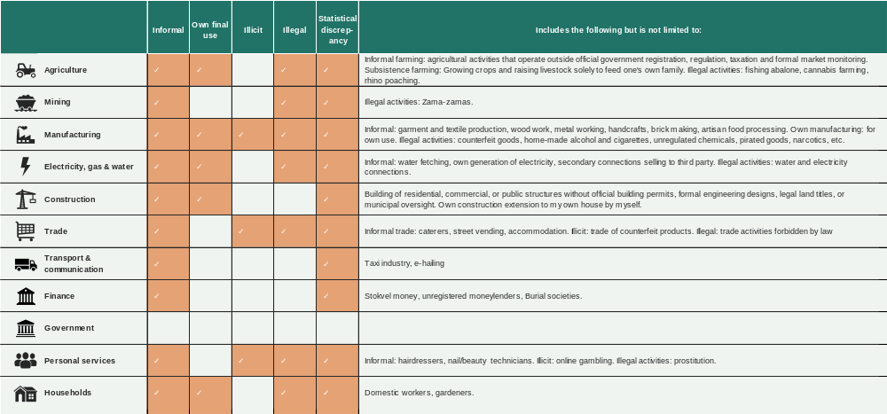
2022 benchmark year in more detail: Where is Stats SA measuring the non-observed economy?
26

Slide 27
Contribution of the non-observed economy over time
If non-profit institutions are excluded, the non-observed economy accounted for 8,7% of economic activity in 2022
Non-observed economy
Observed economy
2015
· Retail chains expanded into townships, complementing unrecorded local traders. · FICA implementation and micro-business turnover taxes forced many entities to register formally.
2005
· Domestic economic boom allowed cash-heavy, unregistered micro-enterprises to flourish. · Many profitable small businesses were unmonitored.
2002
· Informal businesses and domestic workers were not registered.
27

Slide 28
Contribution of the non-observed economy over time
Non-observed economy
Observed economy
2022 (Non-profit institutions excluded from NOE)
2022 (Non-profit institutions included with NOE)
Benchmarked
2015 (Non-profit institutions excluded with NOE)*
*For the 2015 benchmark year, a figure of 8,0% (that includes NPIs) was originally published. The 7,3% is the non-observed contribution without NPIs
28

Slide 29
Contribution of the non-observed economy in each industry in 2022
Just over a quarter of economic activity in the construction industry was non-observed
Non-observed
Observed
29

Slide 30
Contributions to the formal and non-observed economies in 2022
Non-observed economy Total: R551 billion*
Observed economy Total: R5 760 billion
Personal services
9,6%
Trade
13,3%
Manufacturing
13,0%
Trade
21,0%
Manufacturing
14,9%
Households 7,5%
Finance
25,9%
Mining
8,8%
Elec-
tricity, gas & water
3,0%
Transport & communication 6,8%
Mining
7,4%
Finance
5,7%
Electricity, gas & water
5,4%
Transport & communication 17,3%
Personal services
15,0%
Construction 7,2%
Government 8,7%
Con-
struction 2,0%
Agriculture
4,0%
Agriculture
2,7%
NPI
0,6%
*Non-profit institutions are excluded
30

Slide 31
Contributions to the non-observed economy in 2015 and 2022
Non-profit institutions are excluded in 2022
31

Slide 32

30 years of economic change
Photo: Thomas Bennie, unsplash.com
32

Slide 33
Three decades of structural changes in the economy
Percentage contributions to value added
1995 vs 2022
Large shifts mainly caused by reclassification
Large shifts caused by structural changes in the economy
 | Personal services Contribution increased from 5,5% to 15,8%
 | General government Contribution declined from 16,3% to 7,9%
 | Finance Contribution increased from 15,7% to 24,2%
 | Manufacturing Contribution declined from 21,5% to 13,2%
33

Slide 34
Three decades of structural changes in the economy
Industry contributions to value added for by base year
¹⁹⁹⁵
²⁰⁰⁰
²⁰⁰⁵
²⁰¹⁰
²⁰¹⁵
²⁰²²
25%
Finance 24,2%
Manufacturing 21,5%
20%
Government 16,3%
Personal services 15,8%
Finance 15,7%
15%
Trade 14,2%
Trade 14,0%
Manufacturing 13,2%
10%
Transport & communication 9,0%
Mining 8,7%
Government 7,9%
Mining 7,0%
Transport & communication 7,7%
Personal services 5,5%
5%
Agriculture 4,0%
Electricity, gas & water 3,2%
Electricity, gas & water 3,5%
Agriculture 2,9%
Construction 3,2%
Construction 2,5%
0%
Note: The changes reflected by personal services and general government were mainly due to reclassification
34

Slide 35

Annual GDP estimates based on the Supply and Use Tables (SUTs)
Photo: Jerin John, unsplash.com
35

Slide 36
What are the Supply and Use Tables (SUTs)?
The SUTs are a detailed breakdown of the flow of products and services within the economy
The supply (production) table describes the supply of goods and services that are either produced by the local economy or imported
The use (consumption) table describes where and how these goods and services are used, either within the local economy or exported
The newly benchmarked SUTs cover 118 products and services across 214 industries for the years 2018 to 2023. Data for 108 products and services across 125 industries will be published
36

Slide 37
Advantages of the Supply and Use Tables (SUTs)
1
Integrates all three GDP calculation methodologies (production, income, and expenditure) into a single, cohesive framework
2
Provides a quick glance of the main sectors in the economy
3
Shows the structure of the economy
4
Outlines commodity flows in the economy (origin and destination)
37

Slide 38
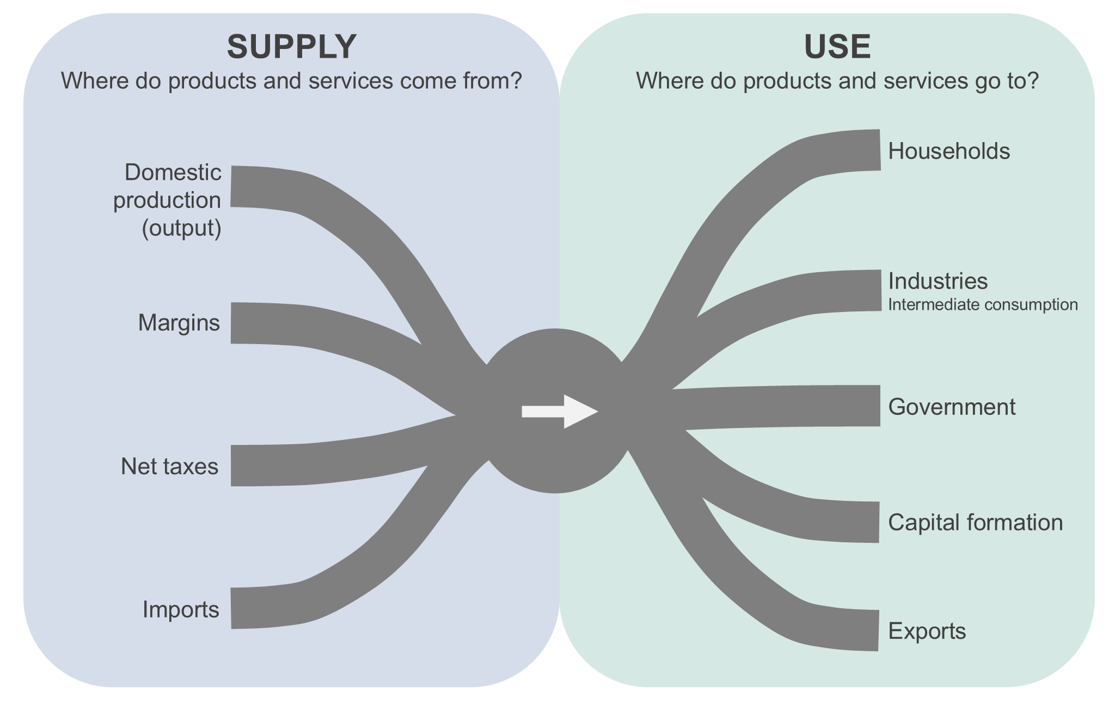
The SUTs can be expressed as a flow diagram
38

Slide 39
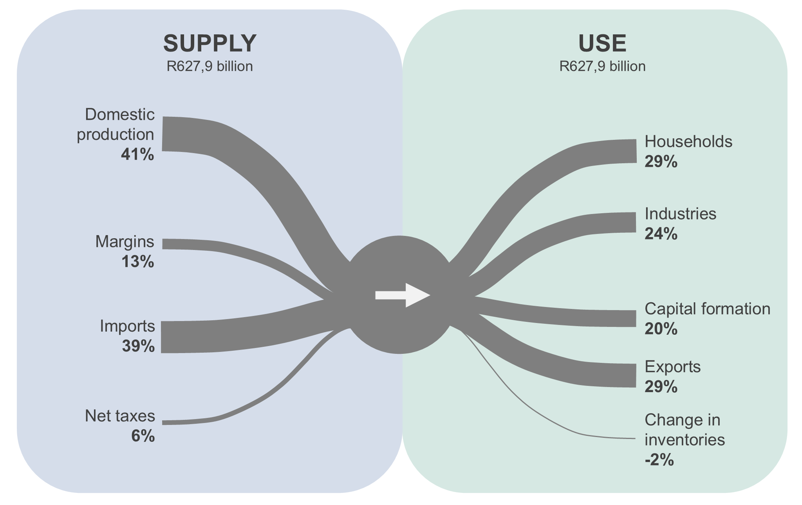
Supply and use of motor vehicles and parts in 2022
Domestic production and imports dominate supply, while exports and households each account for 29% of demand
Percentages have been rounded and may not sum to 100%
39

Slide 40
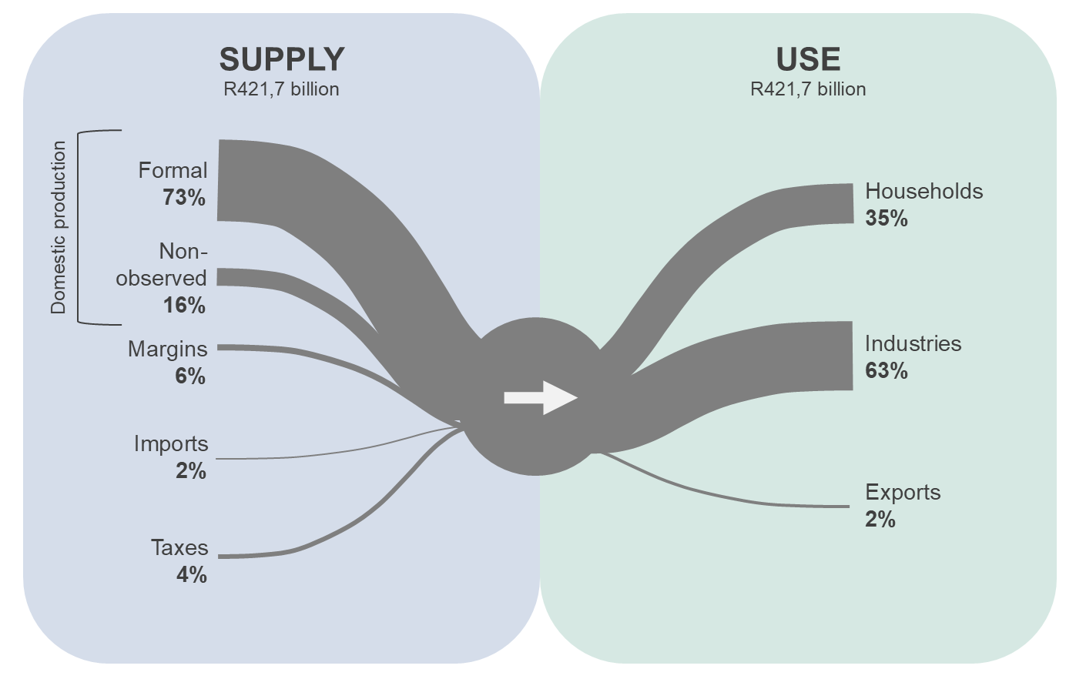
Supply and use of electricity and steam in 2022
Domestic production dominates supply, while industries account for the largest share of demand
Percentages have been rounded and may not sum to 100%
40

Slide 41
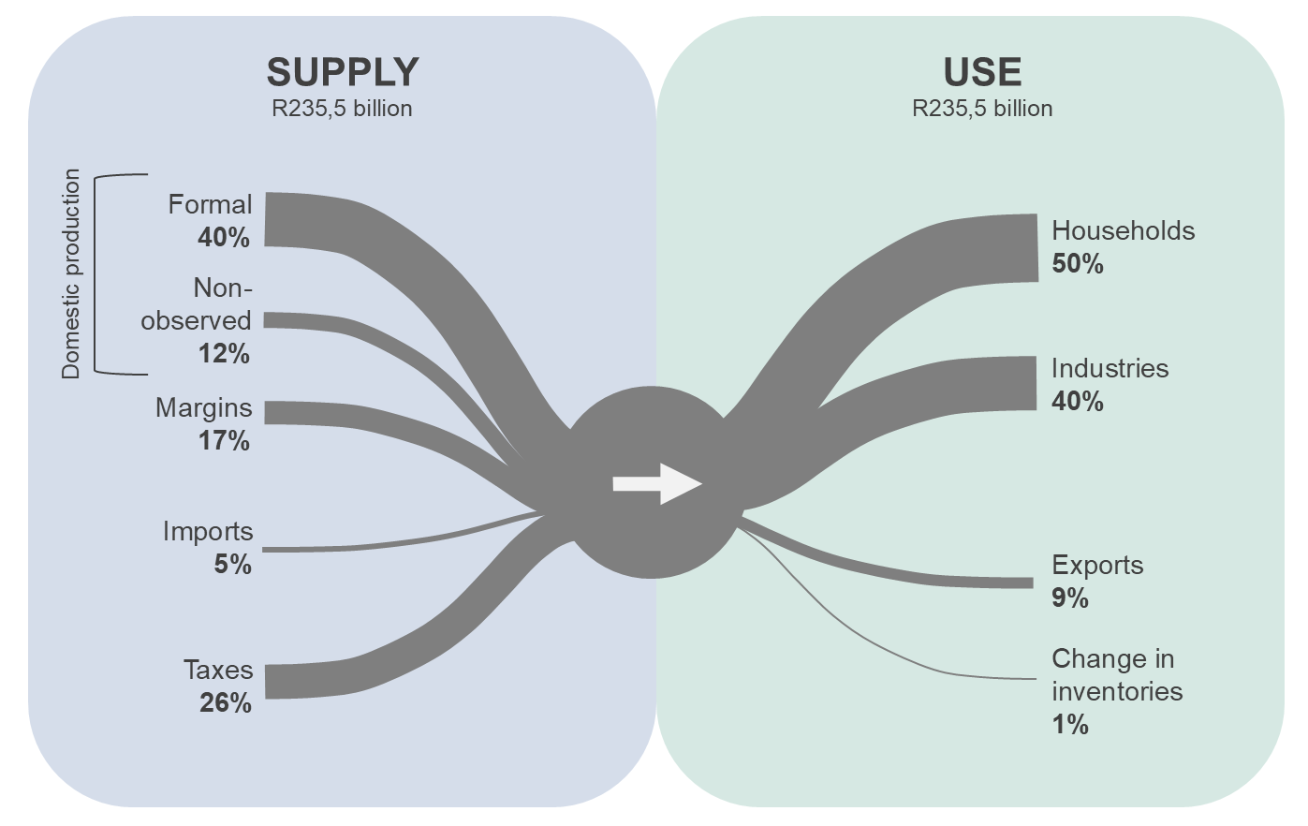
Supply and use of alcoholic beverages in 2022
Non-observed activities accounted for 12% of supply
Percentages have been rounded and may not sum to 100%
41

Slide 42
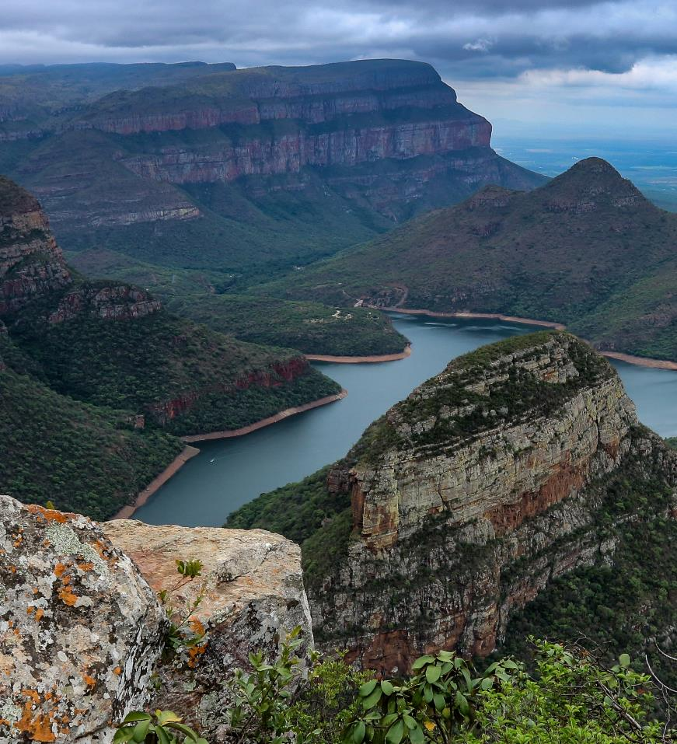
Regional gross domestic product
Photo: Arthur Hickinbotham, unsplash.com
42

Slide 43
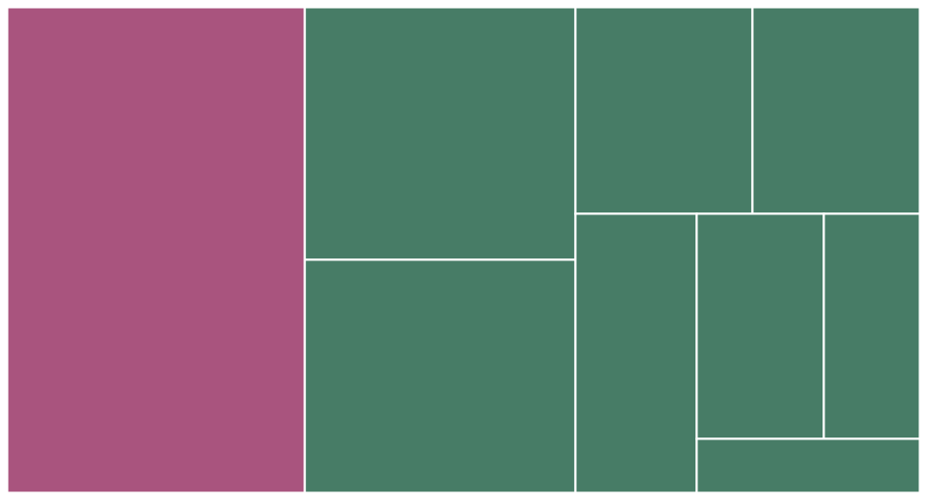
Gauteng was the largest economy, contributing 32,5% to South African GDP
Percentage contribution to national GDP in 2025, current prices (Total: R8,0 trillion)
Limpopo
8,3%
Mpumalanga
7,6%
KwaZulu-Natal
15,5%
Gauteng
32,5%
North West
6,5%
Free State
4,8%
Eastern Cape
7,8%
Western Cape
14,2%
Northern Cape 2,7%
43

Slide 44
All provincial economies expanded in 2025, with Western Cape recording the highest growth rate
Annual percentage change in regional GDP between 2024 and 2025
Constant 2022 prices
GP
1,1%
LP
1,0%
South Africa
0,9%
NW
0,9%
MP
0,5%
FS
0,8%
KZN
0,7%
NC
0,9%
EC
0,6%
WC
1,4%
44

Slide 45
In 2025, Northern Cape had the highest GDP per capita of R146 888
GDP production: Growth figures for Q4: 2020
Gauteng has the highest GDP per capita in the nation
GDP: Constant 2022 prices Population source: Mid-year population estimates, 2026 (includes data for 2025)
45

Slide 46
Nationally, finance was the largest industry in 2025
GDP production: Growth figures for Q4: 2020
Gauteng has the highest GDP per capita in the nation
Percentage contribution to GDP
In current prices
46

Slide 47
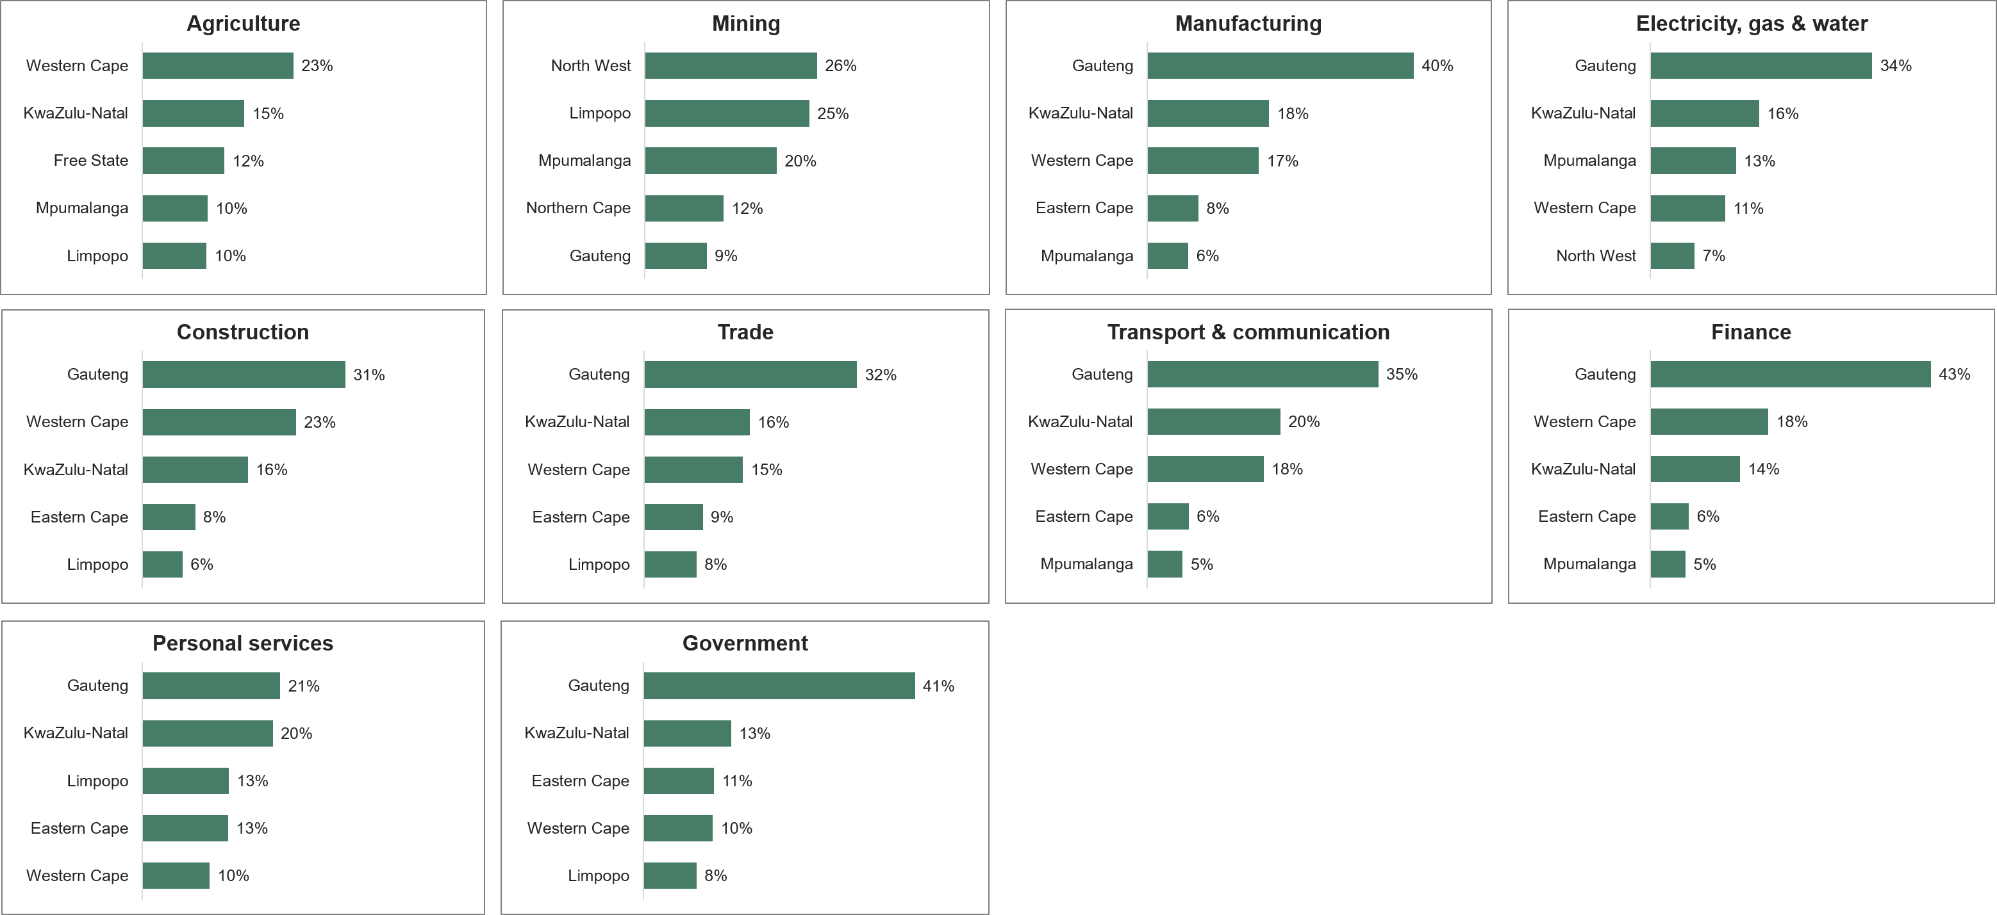
In which provinces are industries mainly concentrated?
Every
GDP production: Growth figures for Q4: 2020
Distribution of industrial activity across South Africa. Provincial contributions to national industry value added, 2025
In current prices
47

Slide 48
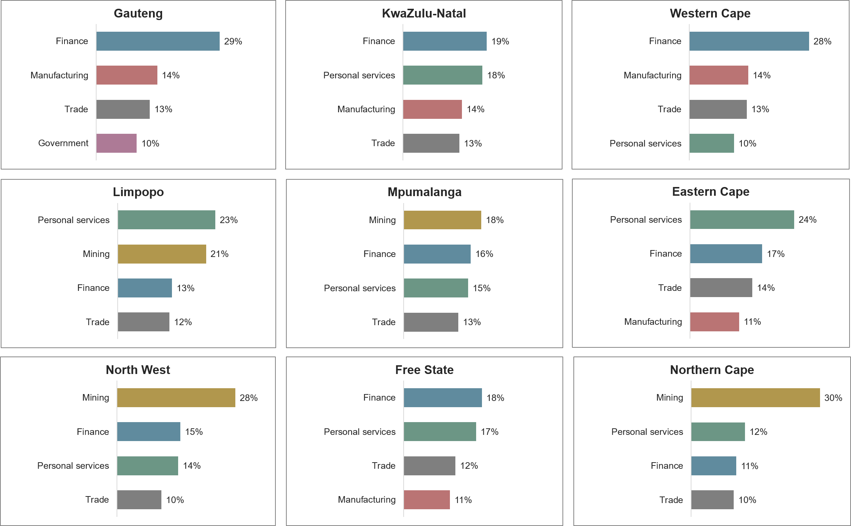
Provincial industry composition in 2025
Every
GDP production: Growth figures for Q4: 2020
The four largest industries in each province. Percentage contribution to provincial GDP
In current prices 'Taxes less subsidies on products’ is not displayed
48

Slide 49
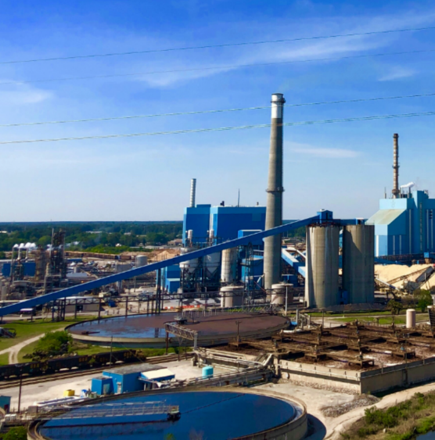
Moving forward
Photo: Francisco Molina Rizzo, unsplash.com
49

Slide 50
Moving forward
2026
2027
29 Oct
29 Oct
November
March
June
Rebased GDP
GDP regionals restated and new data point
Detailed back series
TSA restated and new data point
Agriculture methodology overhaul
New seasonal factors
50

Slide 51
Need to know more?
Download the following from our website (http://www.statssa.gov.za)
  National Accounts: Sources and Methods: benchmarked and rebased estimates of Gross Domestic Product, 2026 (Report No. 04-04-04)
  Gross Domestic Product (P0441)
  Provincial Gross Domestic Product (P0441.2)
51

Slide 52




GDP benchmarking
Ndzi hela kwala!
statssa.gov.za
x.com/StatsSA
facebook.com/StatsSA
52

